Slide 1
MIAU Project Tracker
User guide

Slide 2
Purpose of this document
This document will demonstrate how to use the project tracker to log live, completed and upcoming projects, as well as how to extract and update information about these projects.

Slide 3
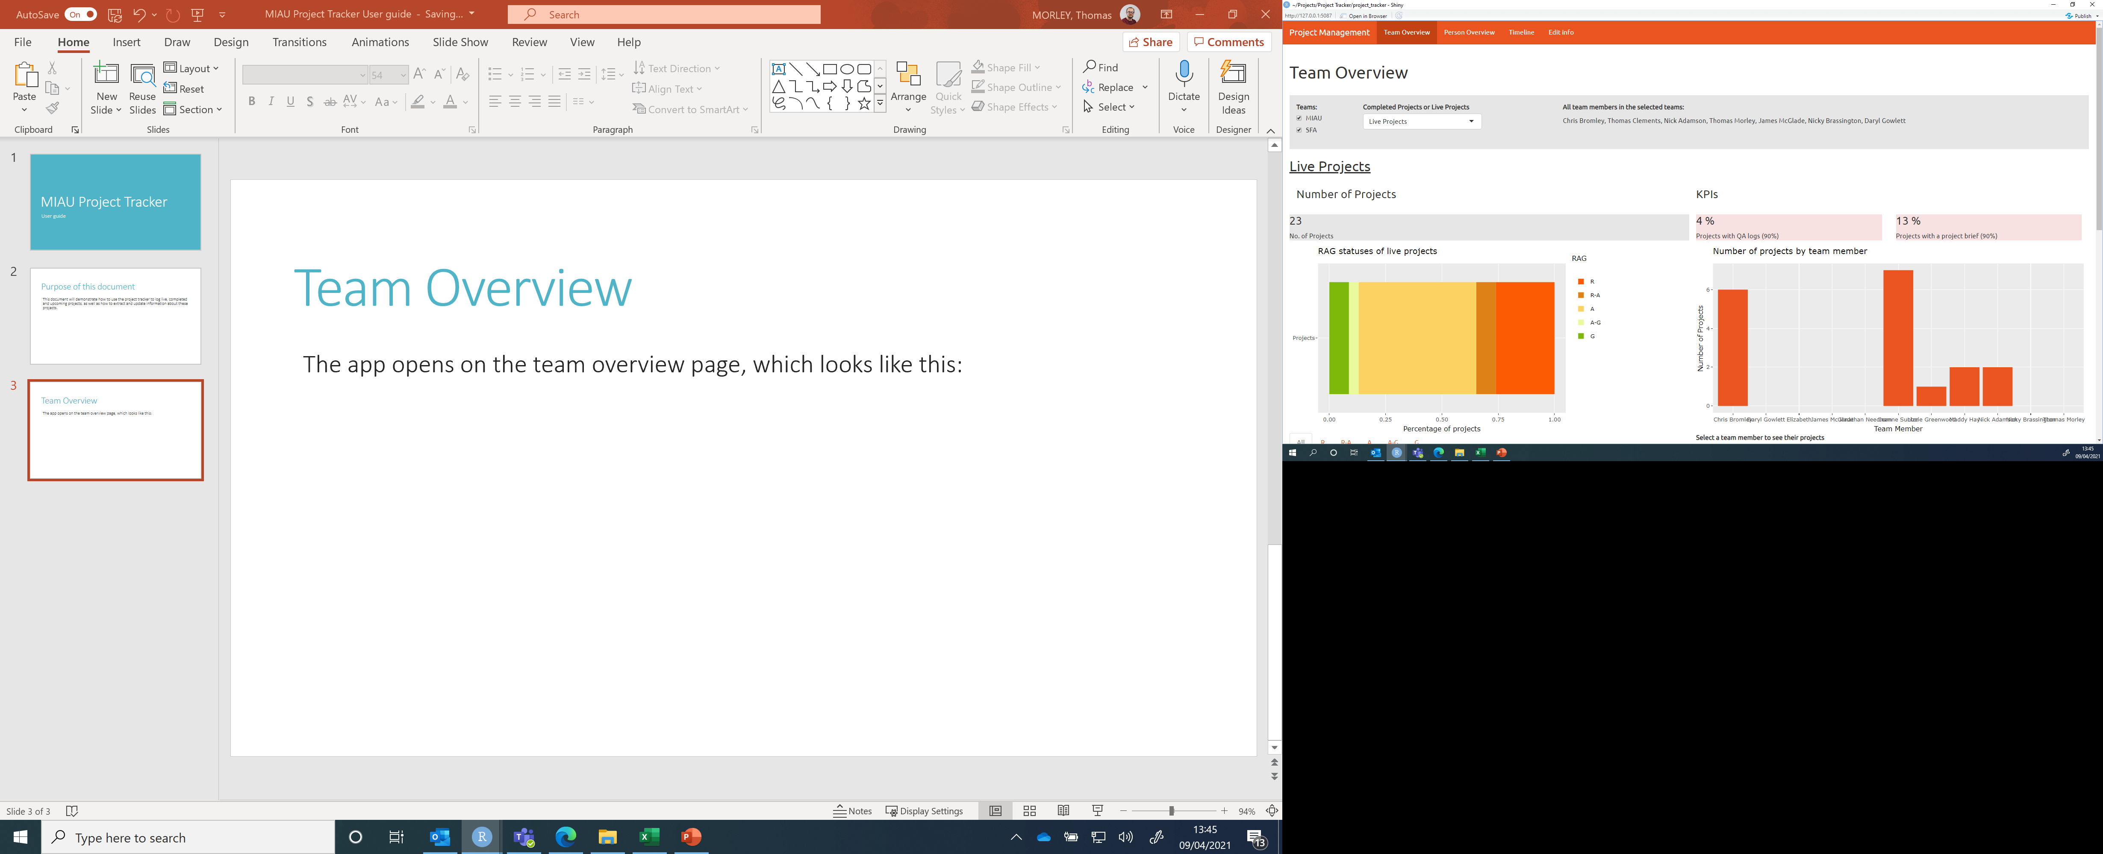
Navigating through the app
The orange bar along the top displays the titles of the different pages. To navigate between the different pages, simply click on the title of the page you want to view.
The app opens on the team overview page, which looks like this:

Slide 4
Team Overview
The bar along the top of the page allows you to select which team you want to look at (as many as you like!) and whether to focus on completed or live projects.

Slide 5
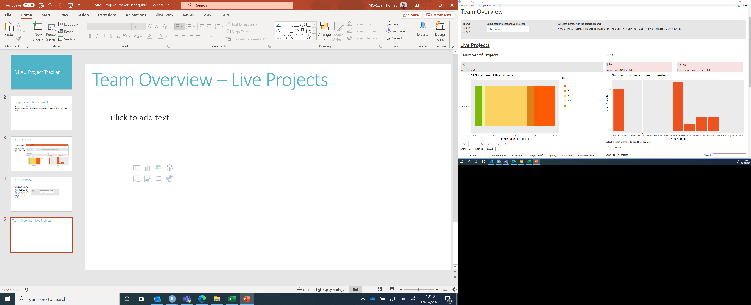
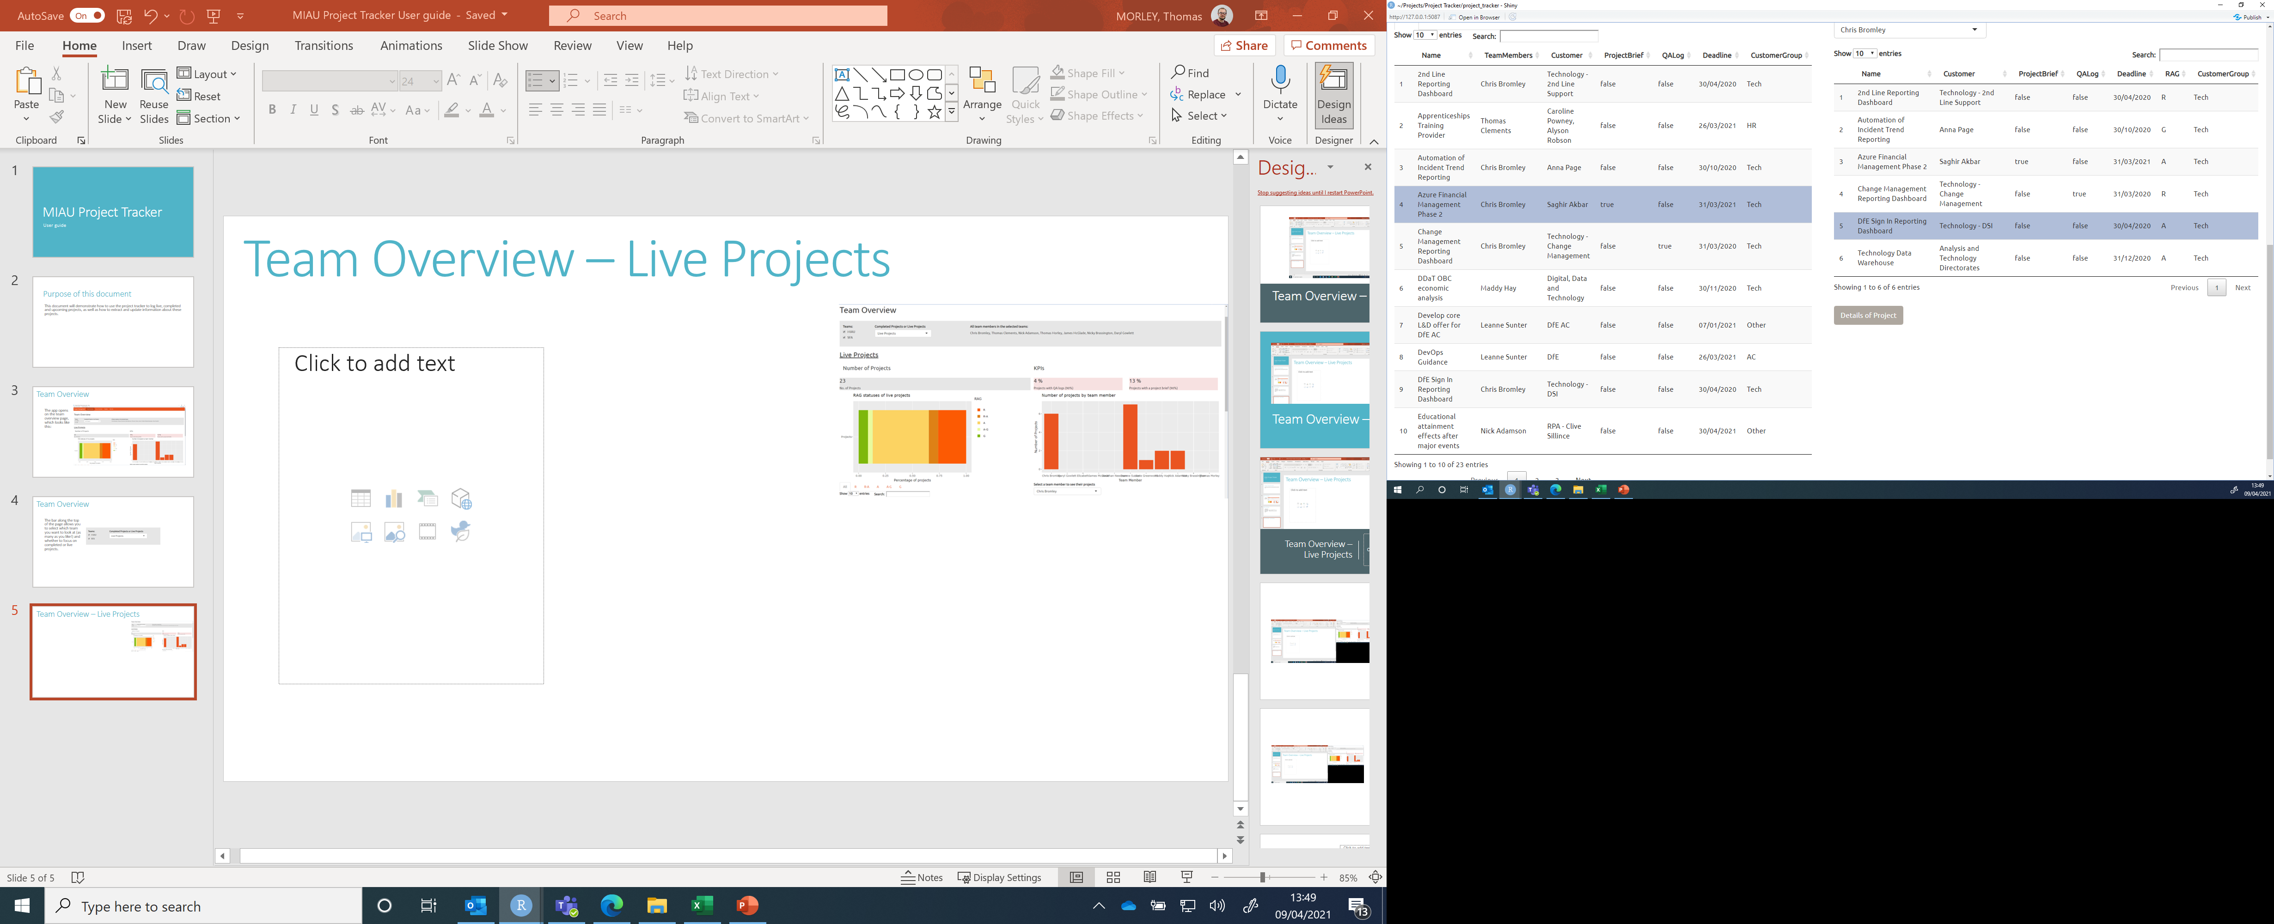
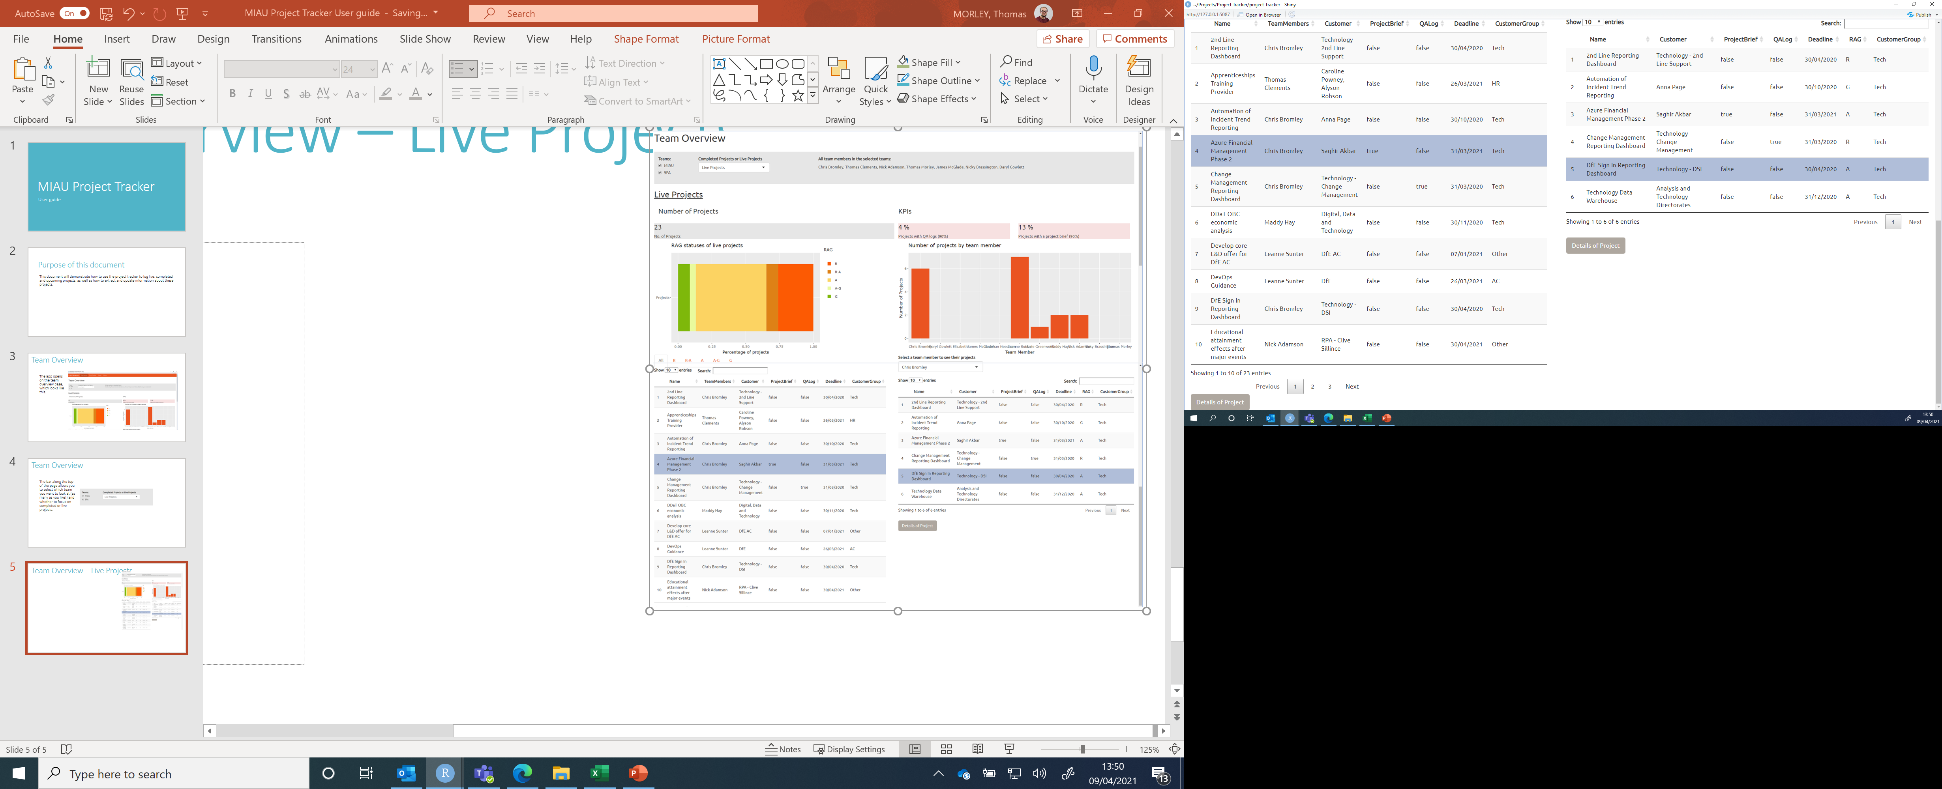
Team Overview – Live Projects
Displays list of current members on the team
Number of live projects
% of projects with QA log/project brief. Colour of box reflects percentage score
Graph displaying percentage of projects by RAG rating
No. of live projects per team member displayed as a bar chart. Names of team members are given along the x-axis.
Select a RAG rating and see all projects with that RAG rating listed below.
Alter number of entries displayed, or click through the pages of entries
Select a team member, and see their live projects listed below.
Click to see more details of each project. Note that this button only appears when a project is highlighted.
Click to see more details of each project. Note that this button only appears when a project is highlighted.

Slide 6
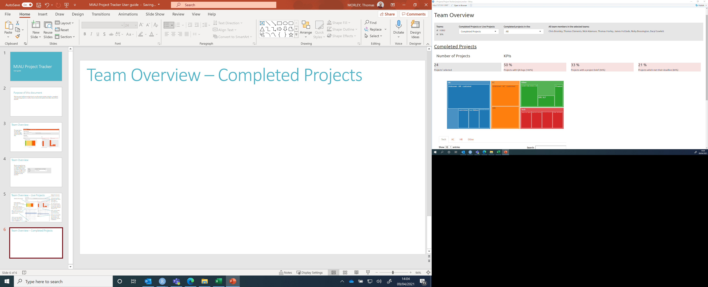
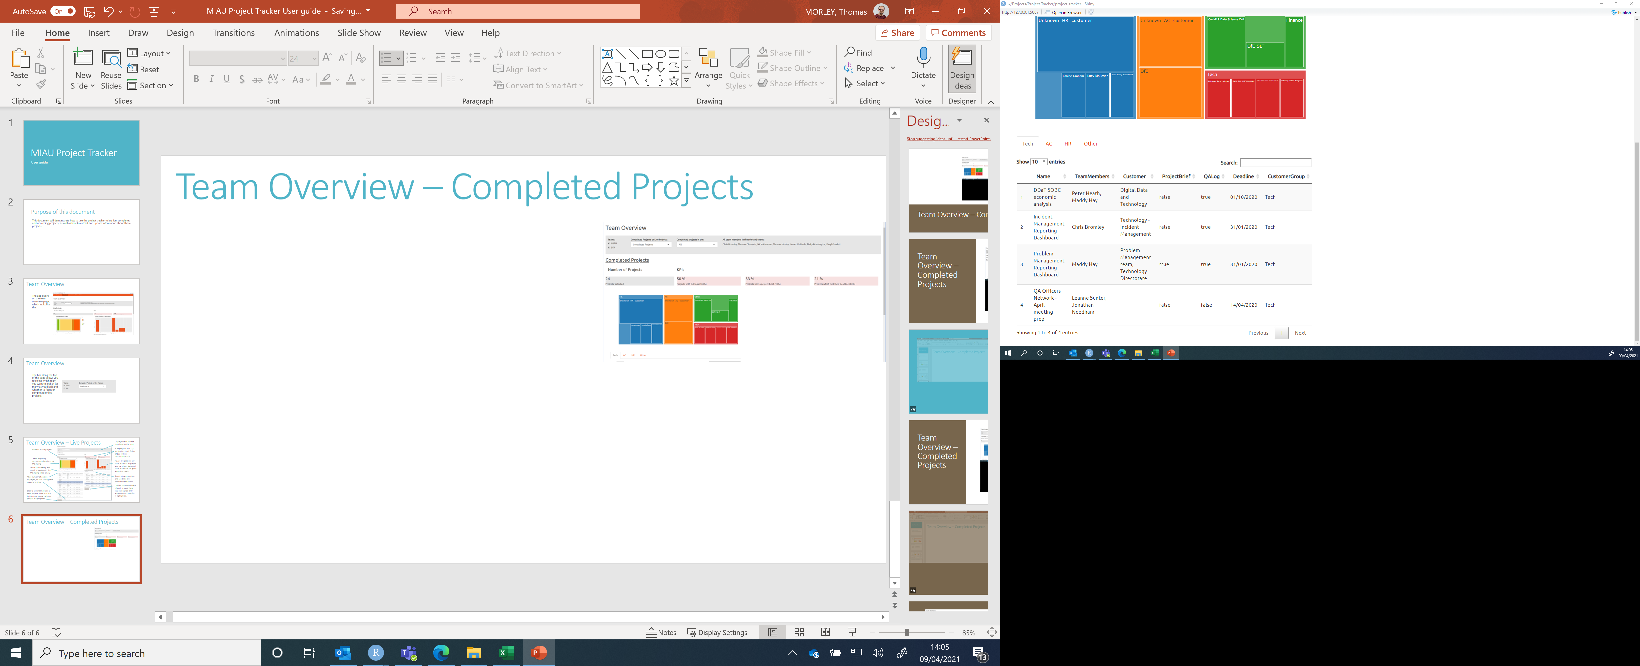
Team Overview – Completed Projects
Select from “Completed Projects in the
Last month
Last 6 months
Last year
Last 3 years
All
% of projects with QA log/project brief/completed on time. Colour of box reflects percentage score
Graph to demonstrate the customers for each project
Number of projects selected
Select the customer group and see all relevant projects displayed below.
The “Details of Project” button will only be displayed if a project is selected!

Slide 7
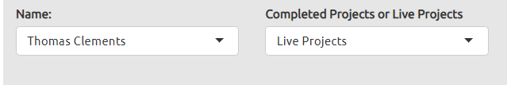
Person Overview
The bar along the top of the Person Overview page allows you to choose the name of the team member you want to look at, and whether you was to focus on their completed or live projects.
Note that past team members do not appear as options.

Slide 8
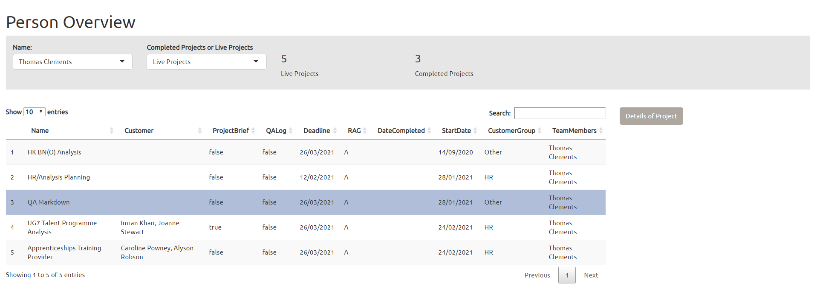
Person Overview – Live Projects
Number of live and completed projects for the selected person are displayed here
List of live projects for the selected person is displayed here
Click here to view more details of the project. Note that this button will not be displayed if a project is not selected.

Slide 9
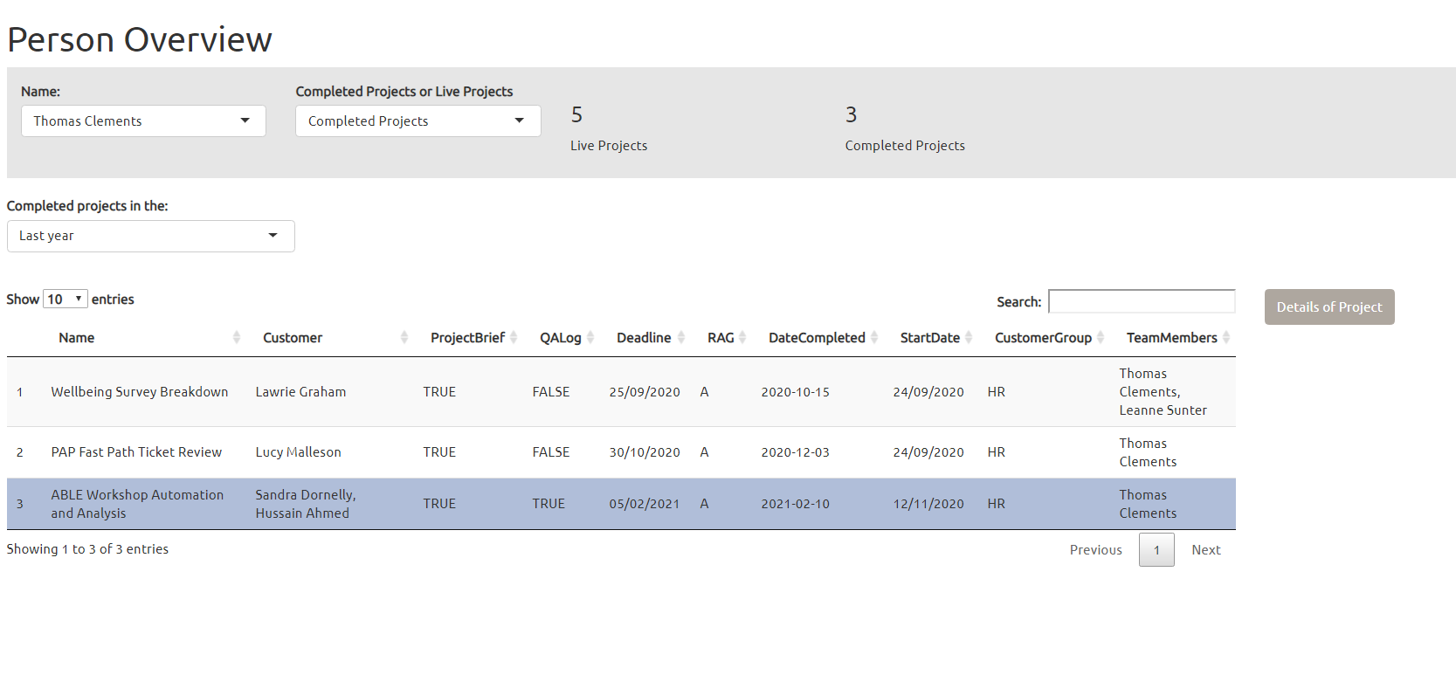
Person Overview – Completed Projects
Number of live and completed projects for the selected person are displayed here
Select from “Completed Projects in the
Last month
Last 6 months
Last year
Last 3 years
All
List of completed projects for the selected person is displayed here
Click here to view more details of the project. Note that this button will not be displayed if a project is not selected.

Slide 10
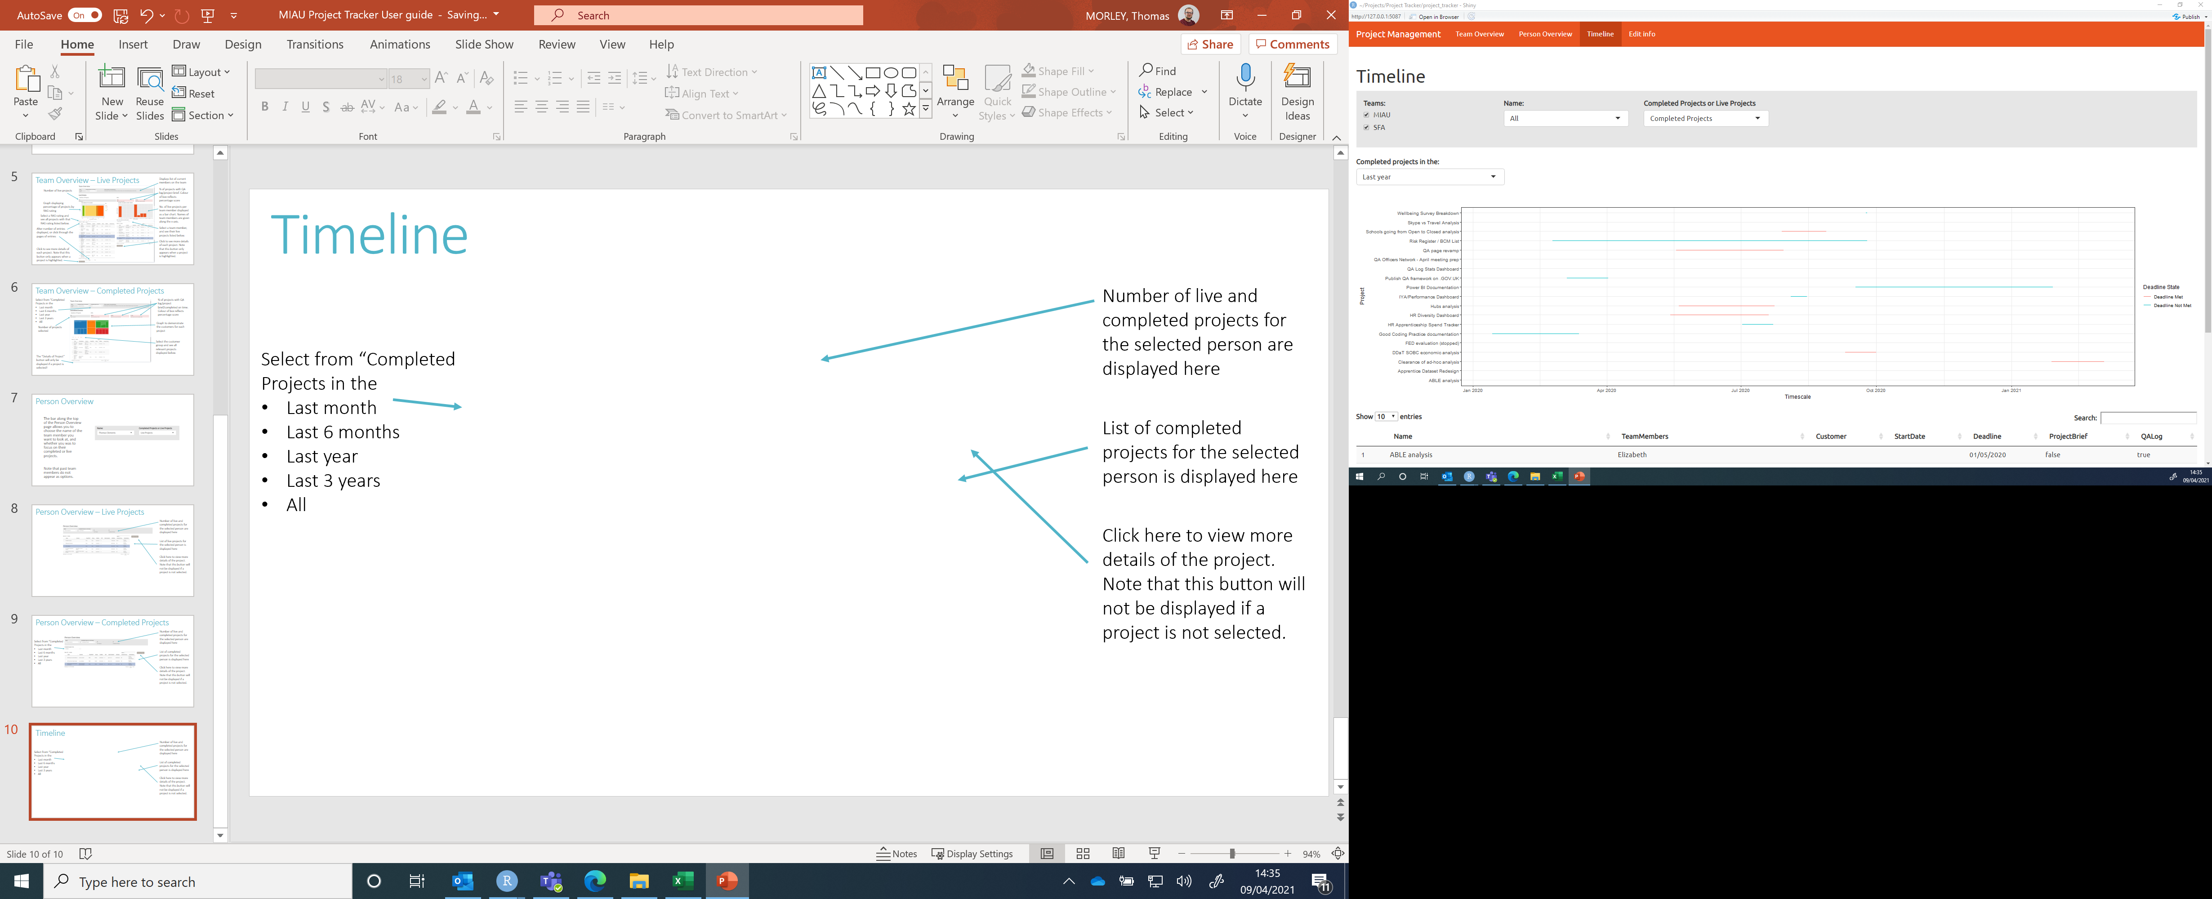
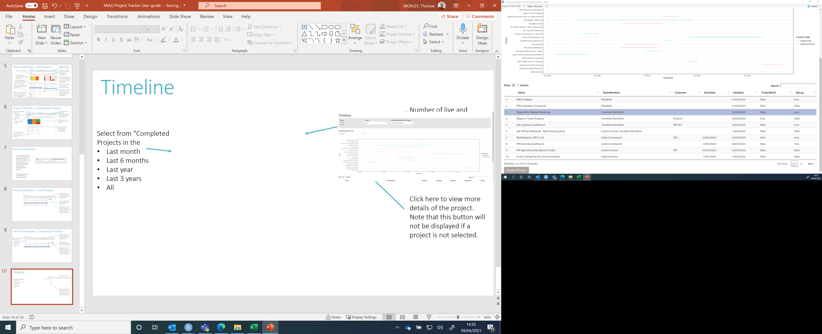
Timeline
Select to display projects from a specific team, from a specific person, just live projects or just completed projects.
When looking at “Completed Projects”, select from “Completed Projects in the
Last month
Last 6 months
Last year
Last 3 years
All
Time dedicated to each individual project is displayed in the form of a gantt chart. They are colour coded – red means that the deadline was met, whilst blue means that the deadline was not met.
All projects displayed in the gantt chart are listed below
Click here to view more details of the project. Note that this button will not be displayed if a project is not selected.

Slide 11
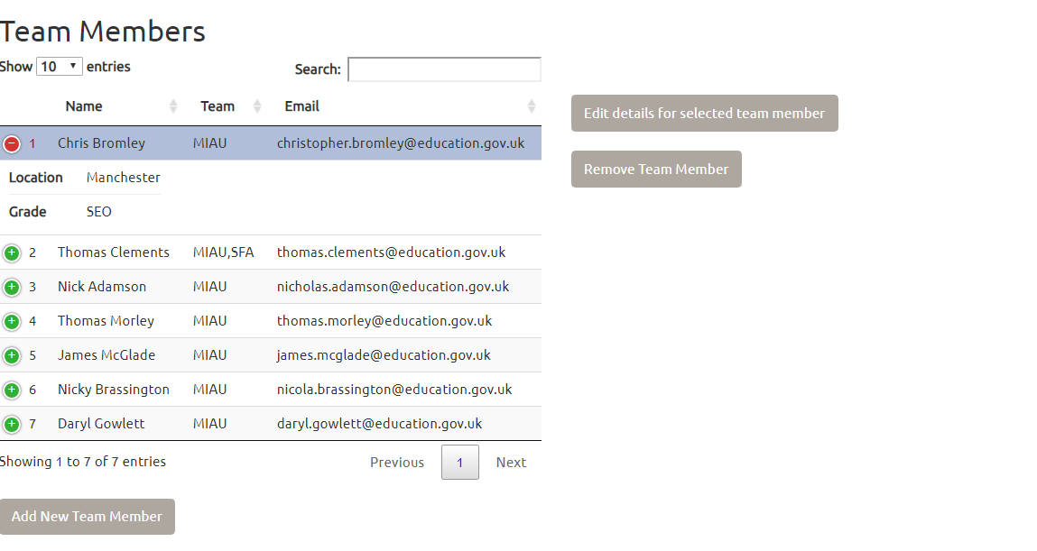
Edit Info – Team Members
The “Edit Info” page is split into two sections. First we shall look at the Team Members section, at the top of the page.
All current team members are displayed in this table.
Click the green + sign shows more information about that person. Click the red – sign to hide this information.
Click here to edit a person’s details, and here to remove a person. Note that these options won’t show up unless a team member is selected.
Click here to add a new team member

Slide 12
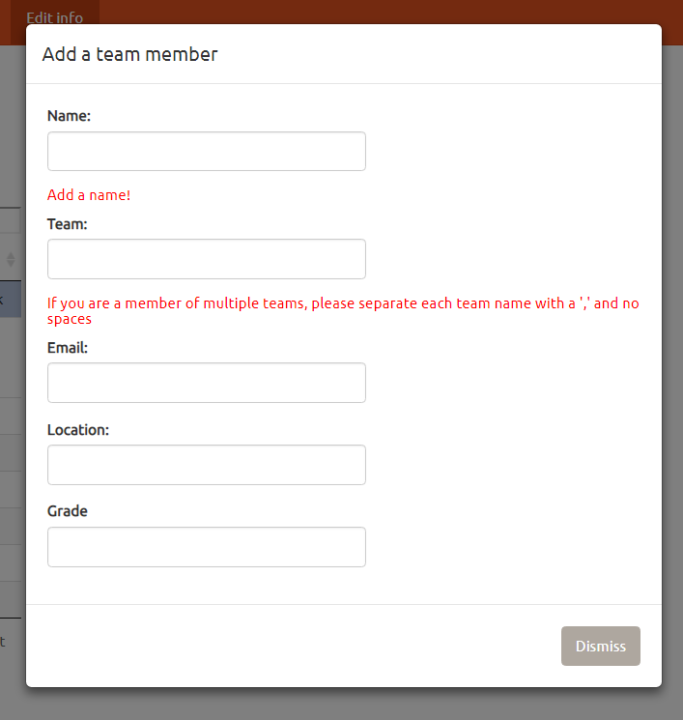
Edit Info – Team Members
Adding a team member
If you wish to reinstate a team member that has been deleted, enter their name here and click “Confirm”.
Note that you cannot have two team members with the same name.
If a member exists across multiple teams, enter each team name with a comma and no spaces in between, i.e. MIAU,SFA
When you click to add a team member, you will see this pop up.
You must enter a name to submit. The other fields do not have to be filled in.
A confirm button will appear at the bottom of the page when a name has been entered.
When editing team members, you will see a similar box with the same options. Edit the information as you need, and then click submit.

Slide 13
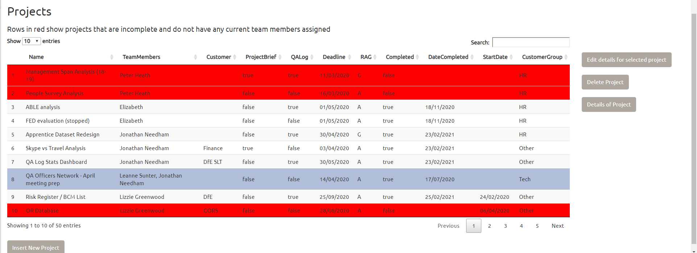
Edit Info – Projects
The “Edit Info” page is split into two sections. We shall now look at the “Projects” section, at the bottom of the page.
Options to edit, delete or view details of project will only be displayed when a project is selected
Rows are red if the project is incomplete and the assigned team member has left the team. This is to ensure that no projects get forgotten about when team members leave.
Change the number of projects displayed on the page
Navigate through pages of projects
Click here to insert new project

Slide 14
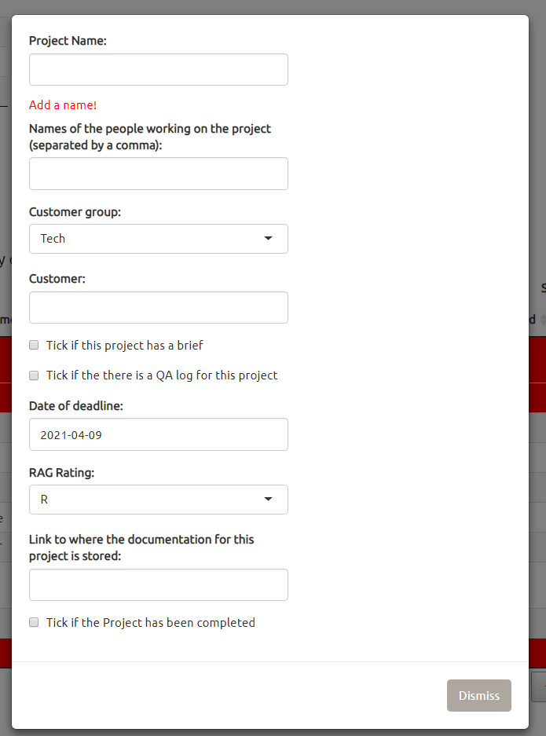
Edit Info – Projects
Adding a new project
If you wish to reinstate a project that has been deleted, enter the project name here and click “Confirm”.
Note that you cannot have two team members with the same name.
When you click to add a team member, you will see this pop up.
You must enter a name to submit. People working on project, customers and documentation links do not have to be filled in. Other fields have defaults which are shown here. The Date of Deadline default is today’s date.
A confirm button will appear at the bottom of the page when a project name has been entered.
When editing projects, you will see a similar box with the same options. Edit the information as you need, and then click submit.

